Slide 1



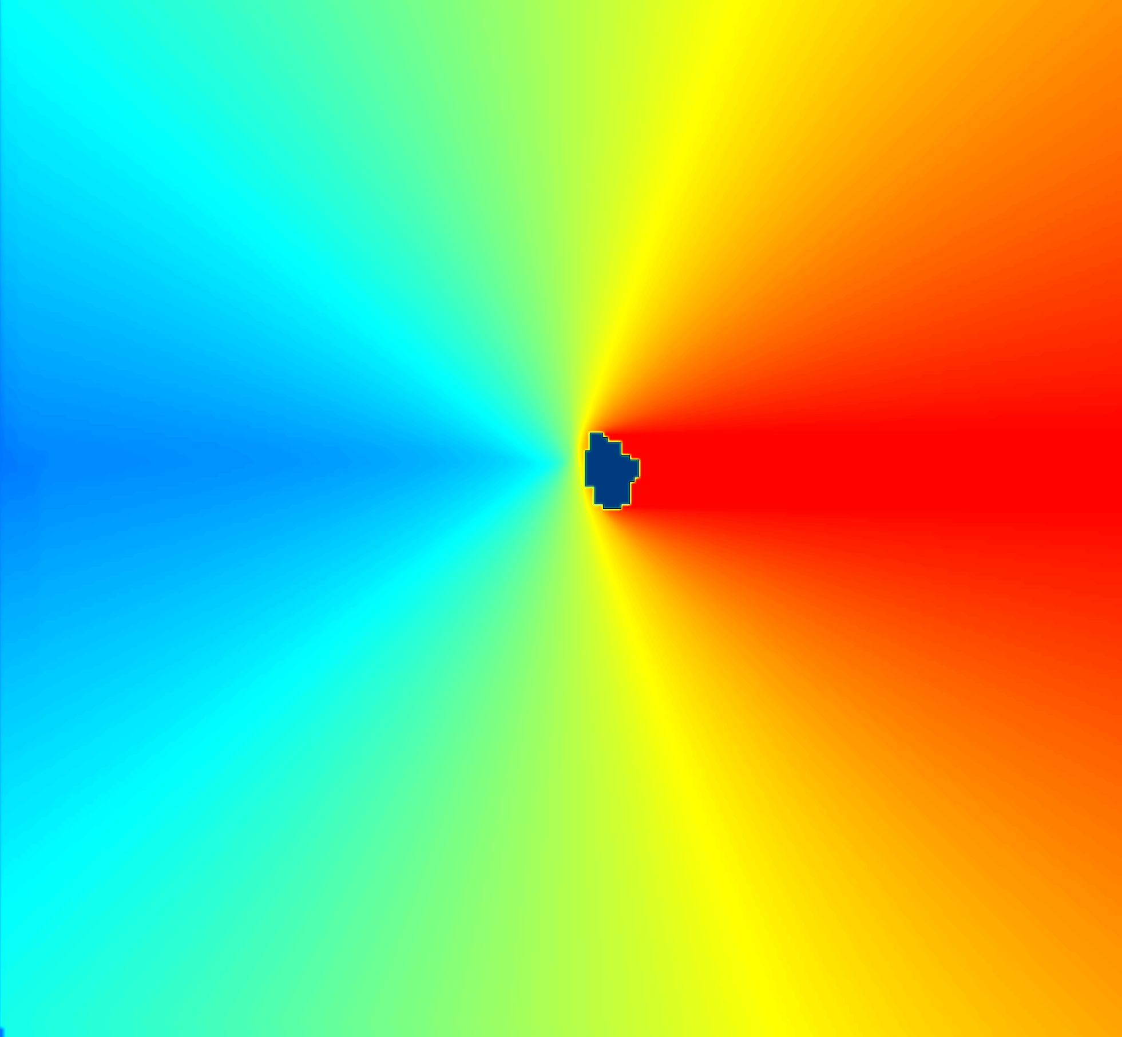
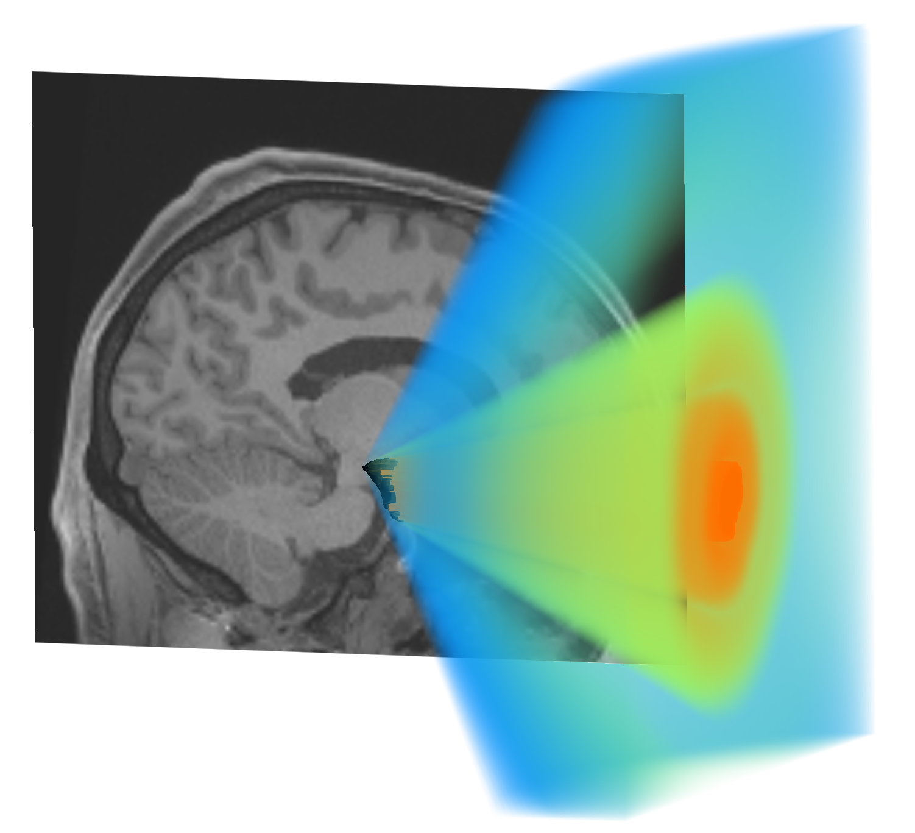
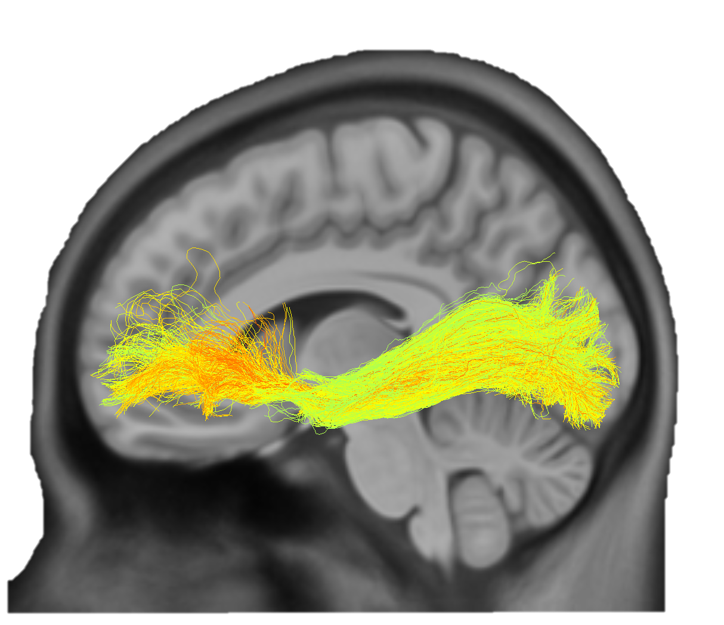
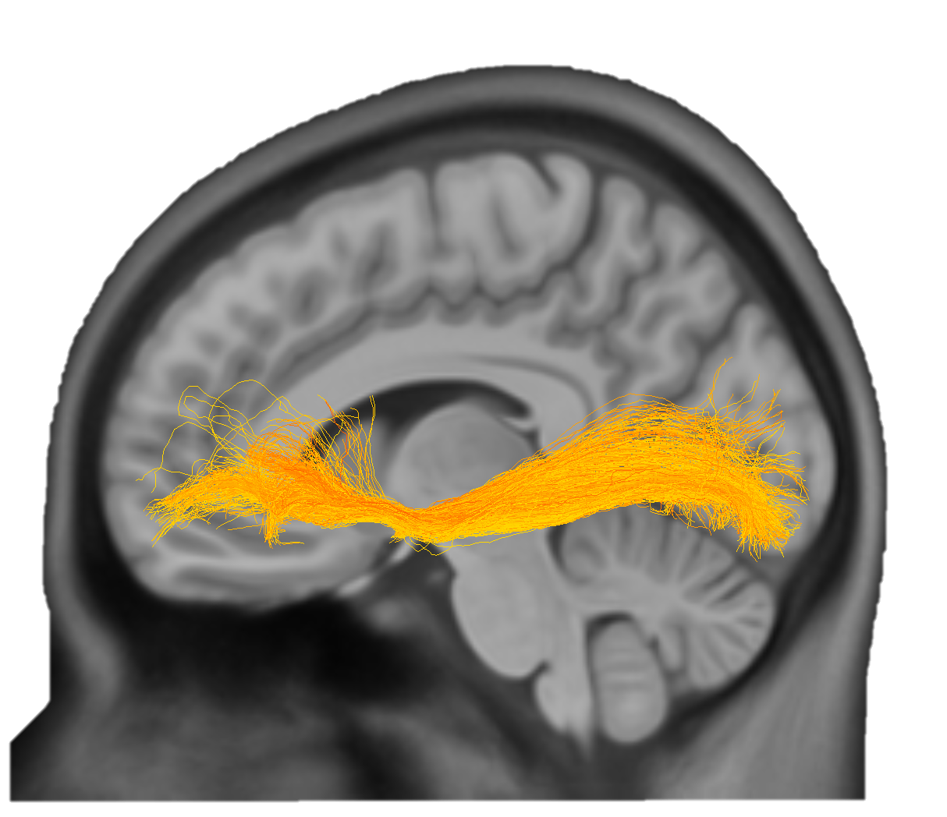
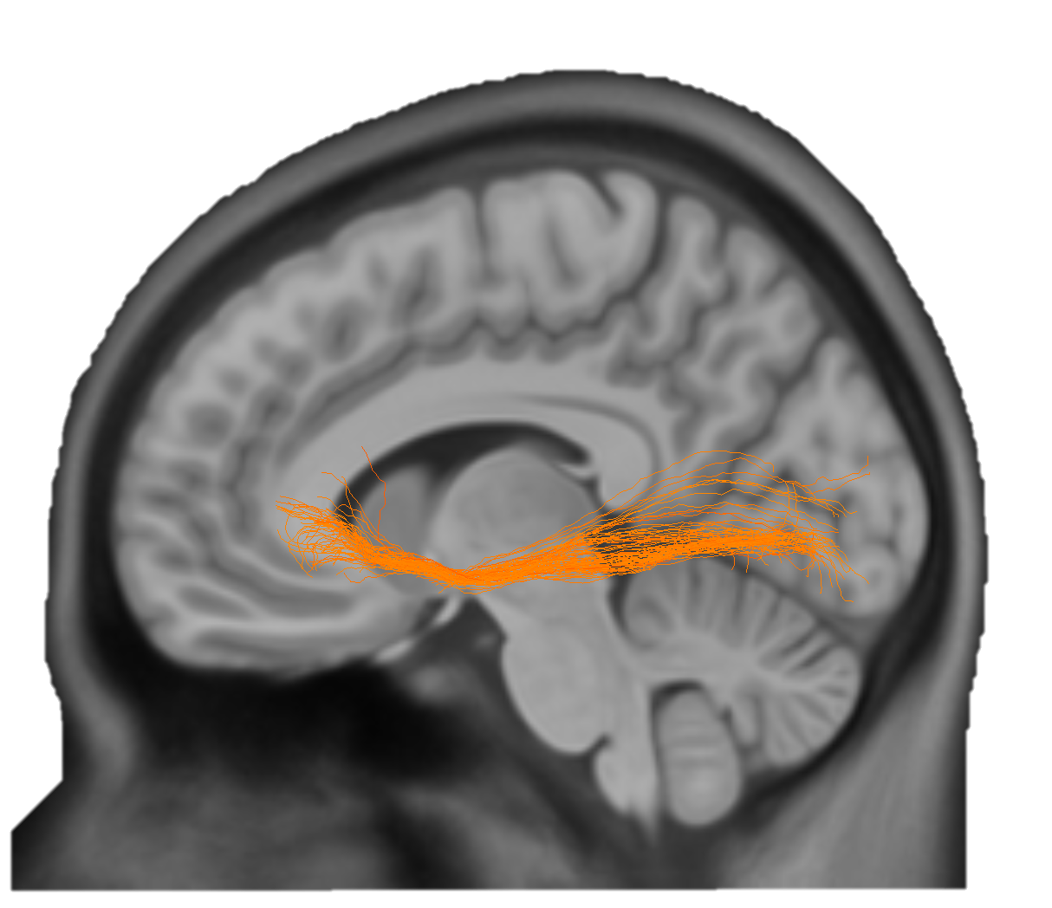
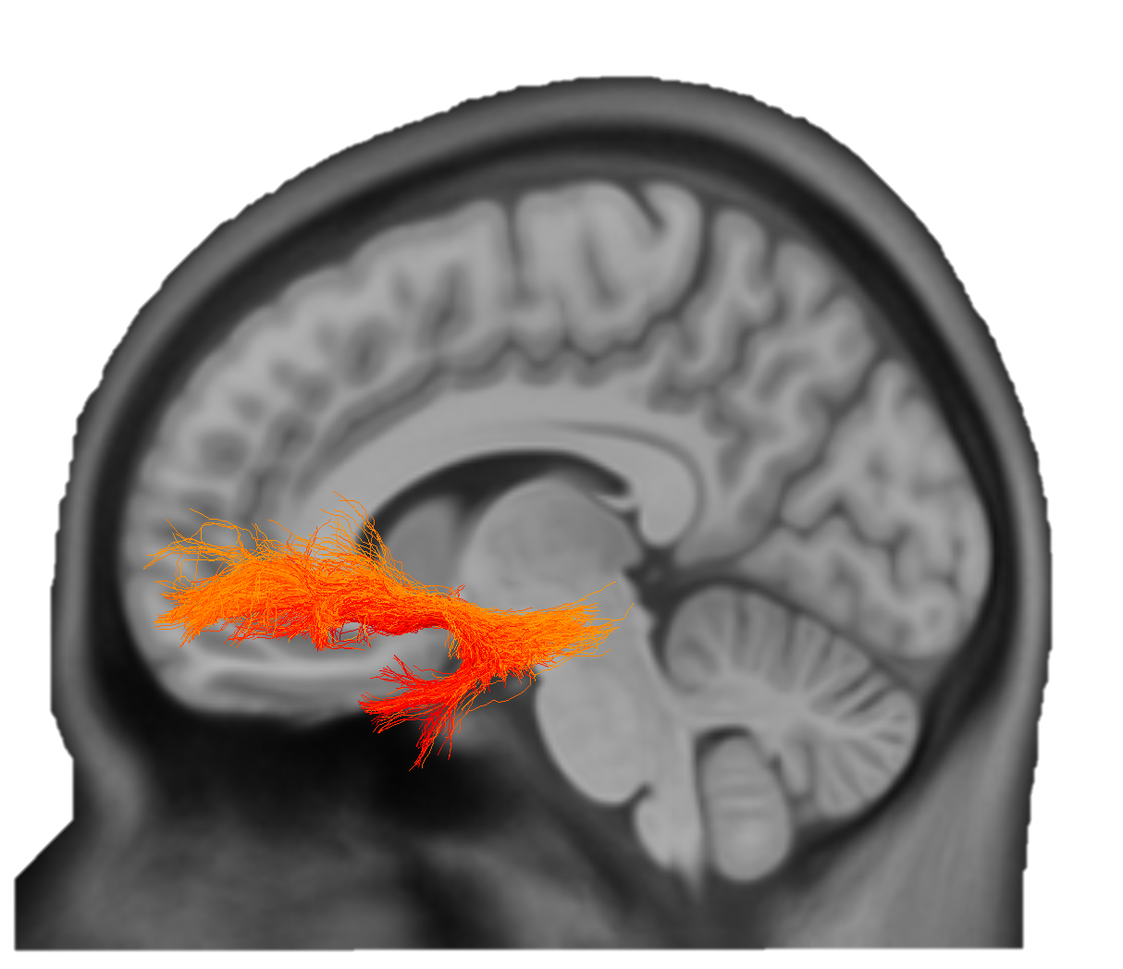
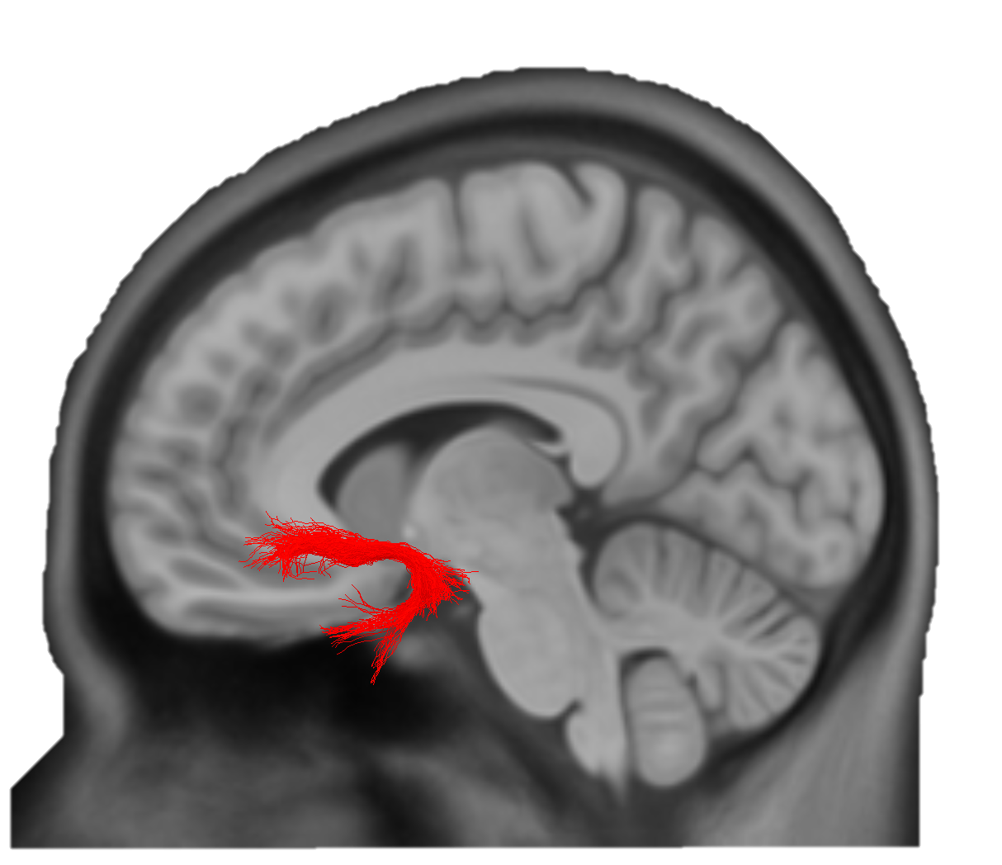

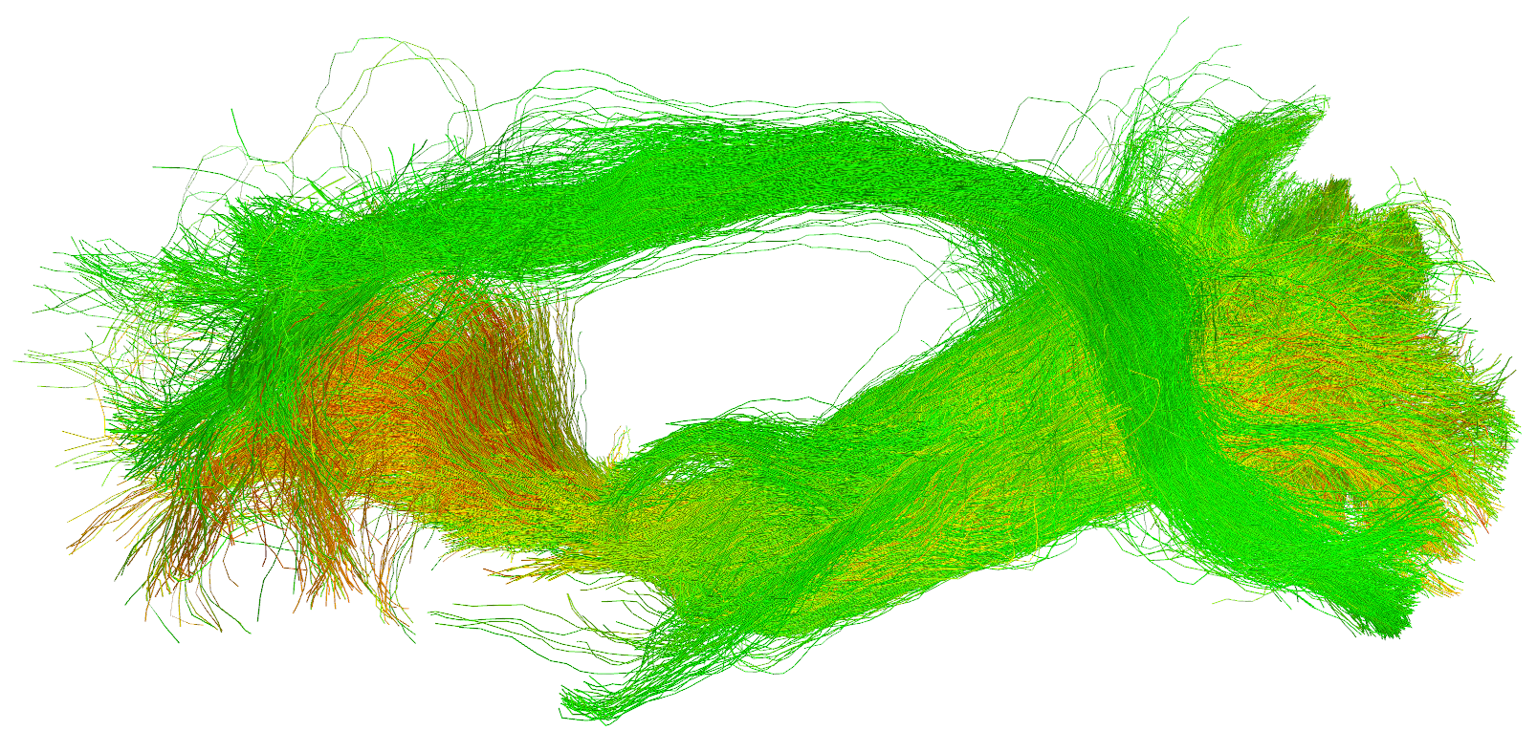
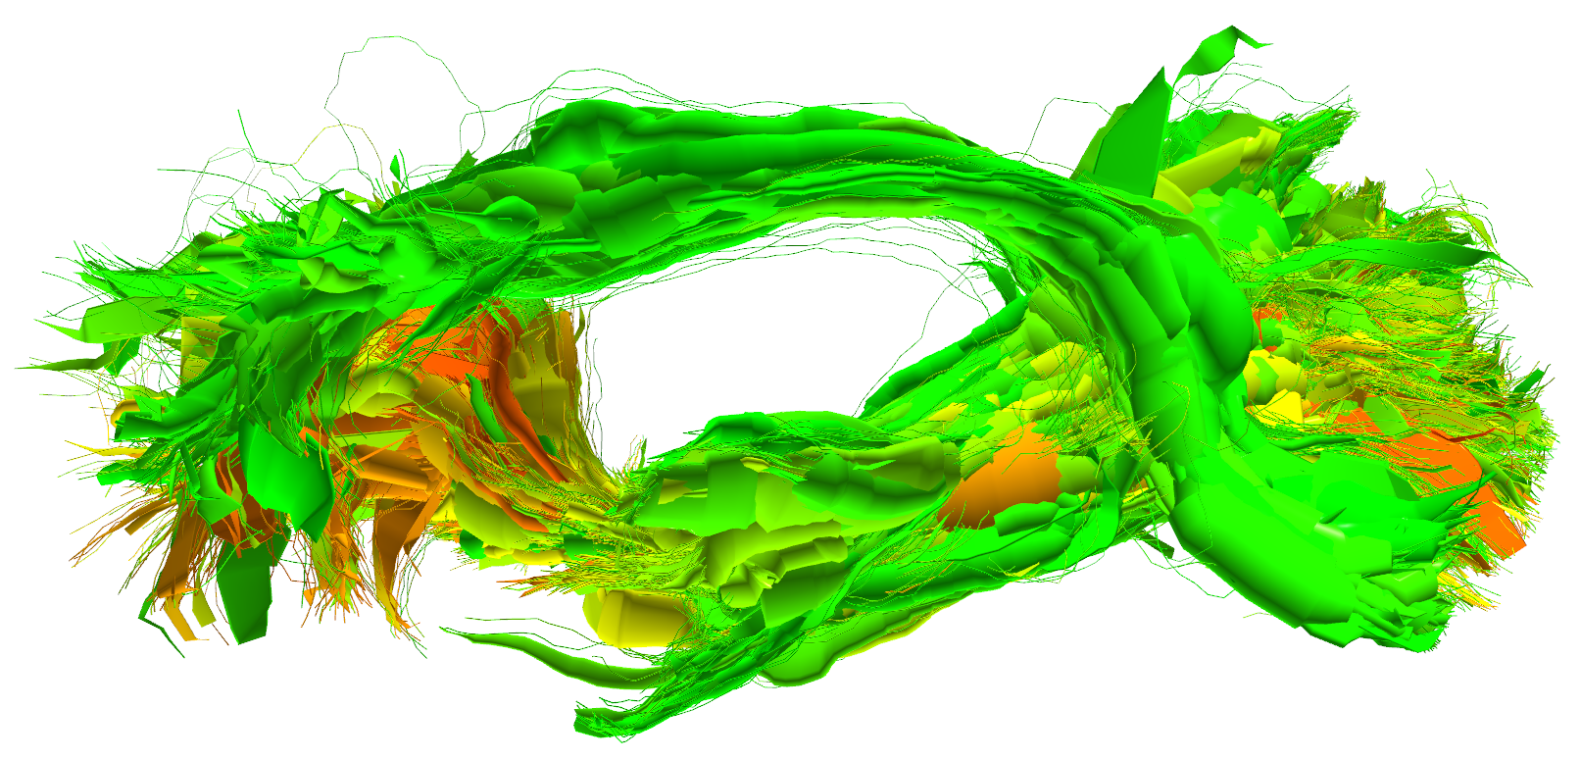
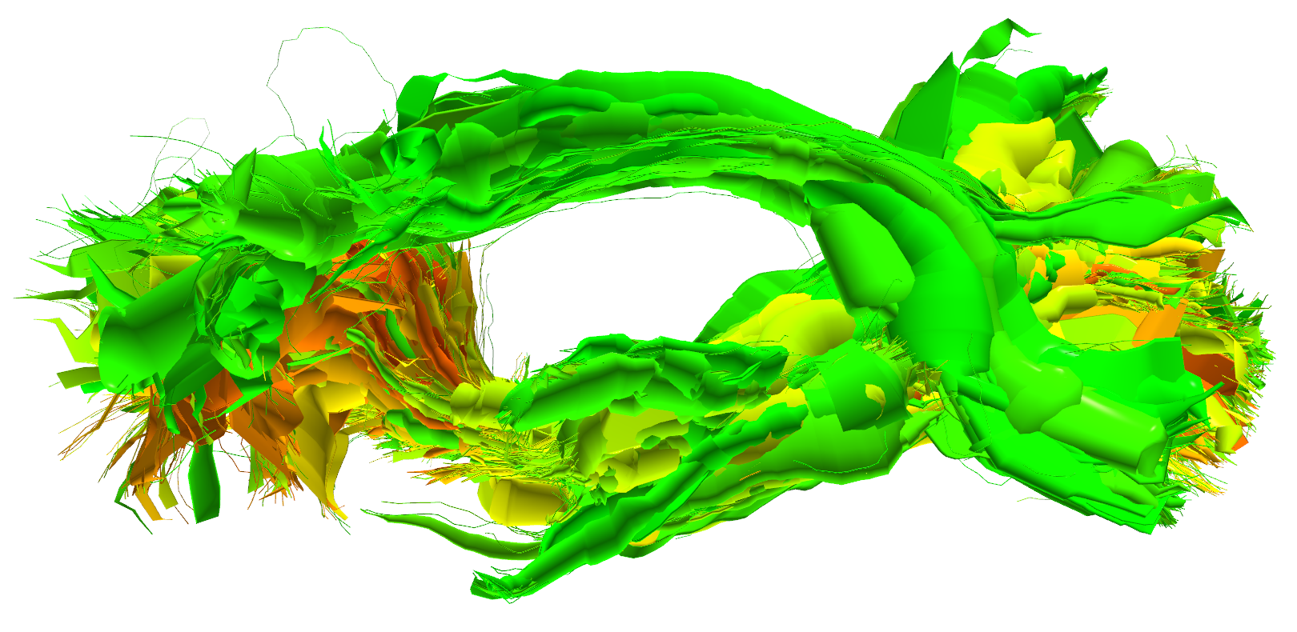
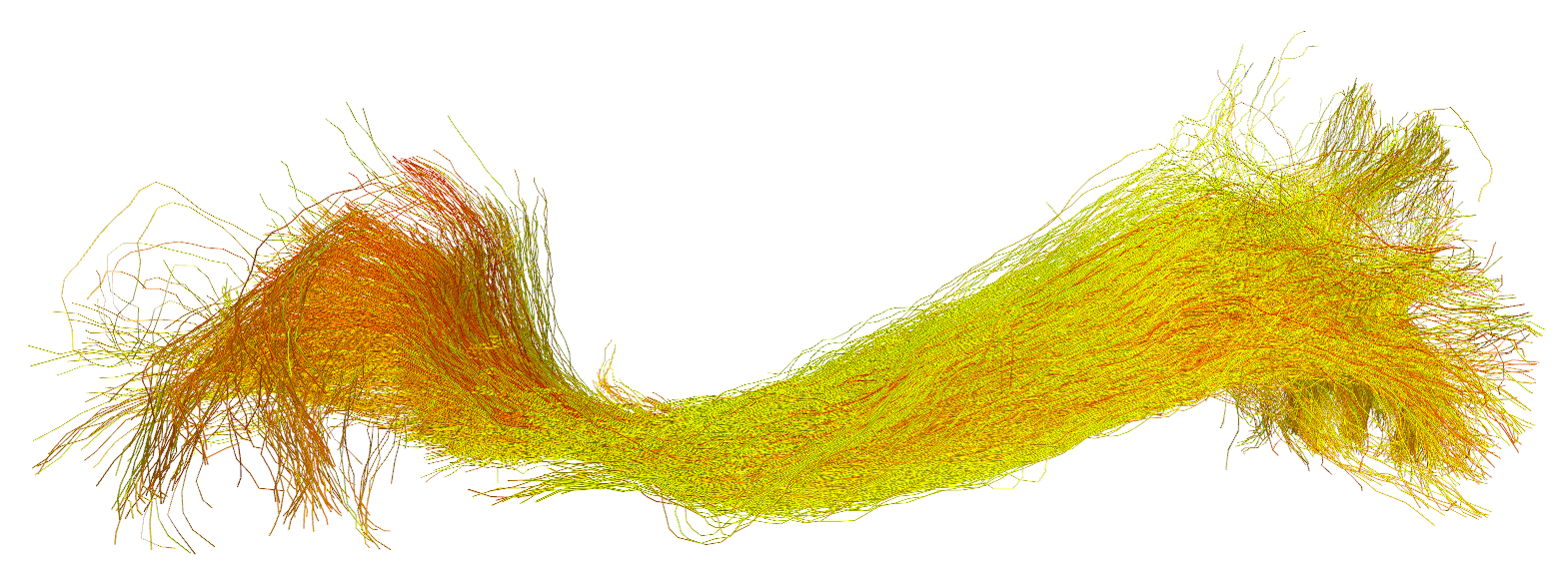
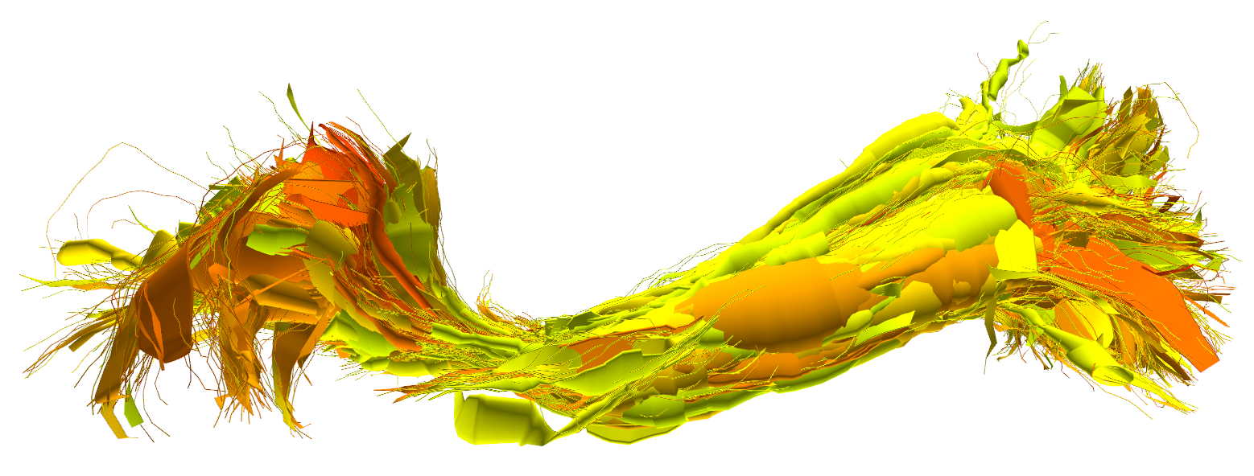
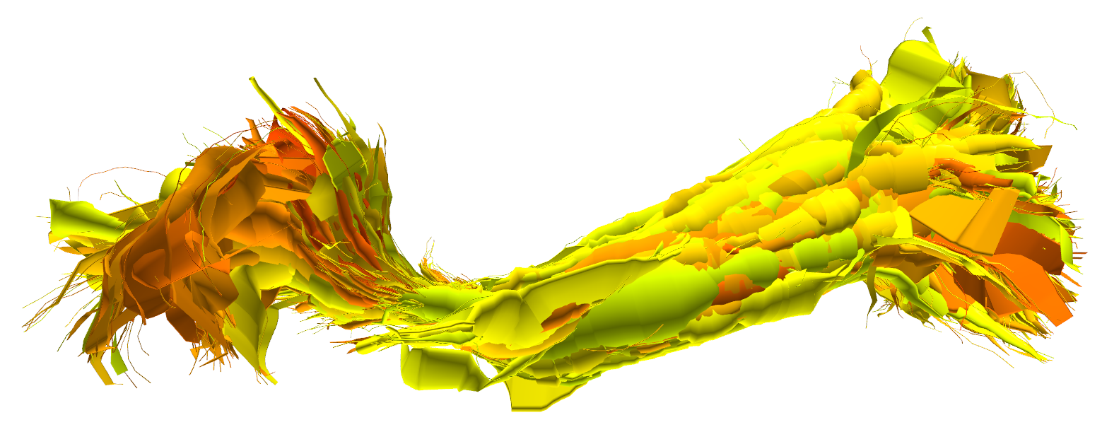
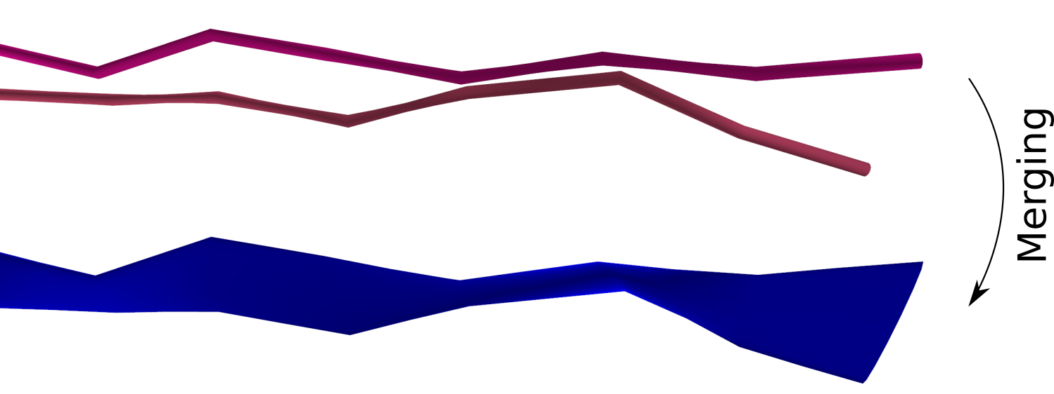
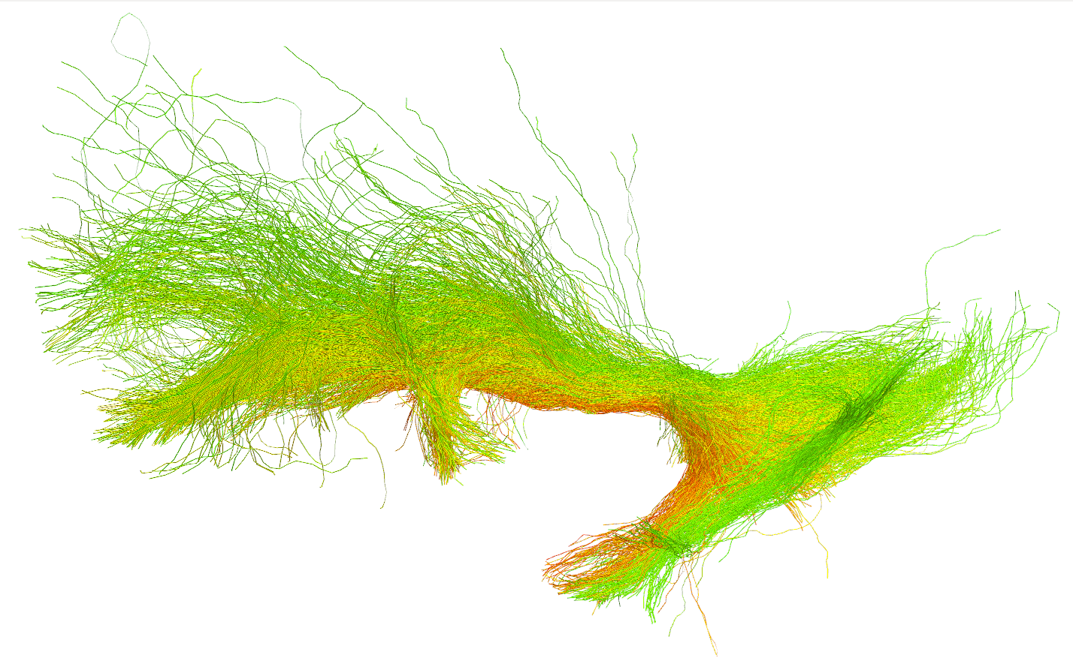
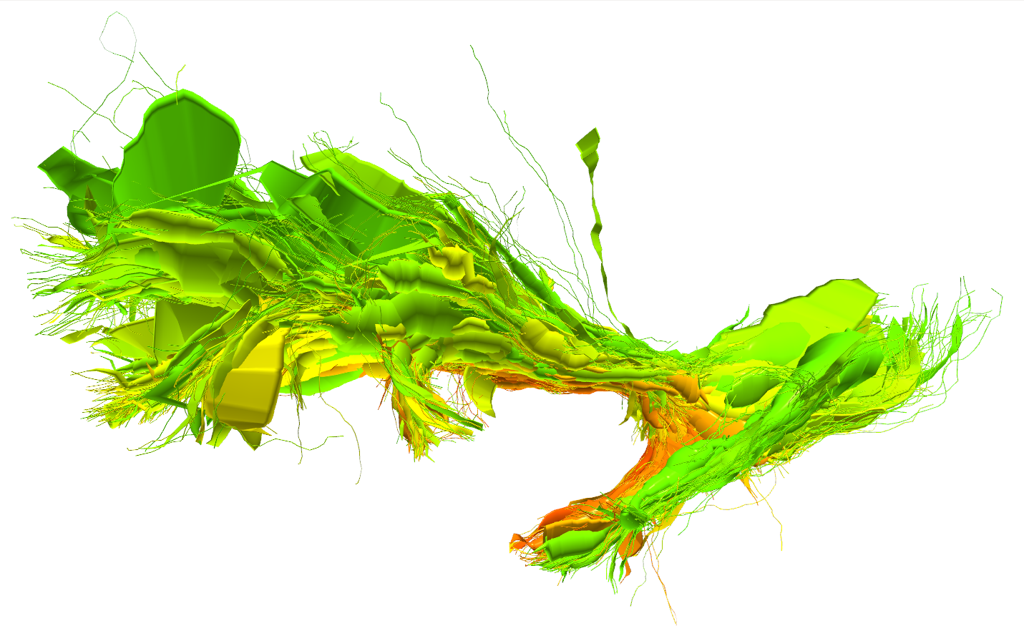
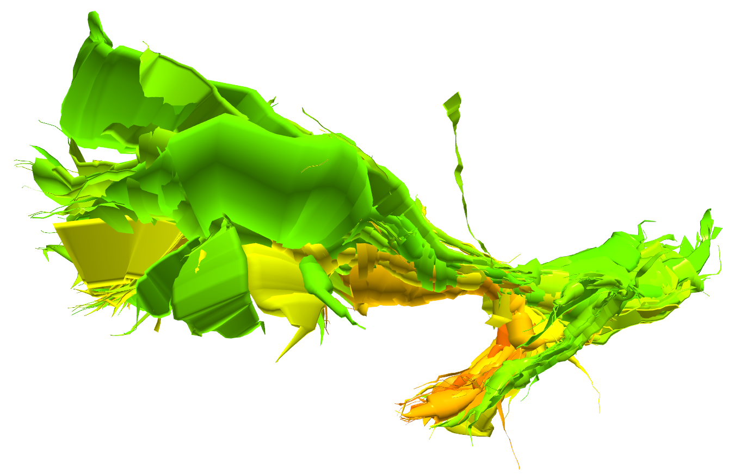
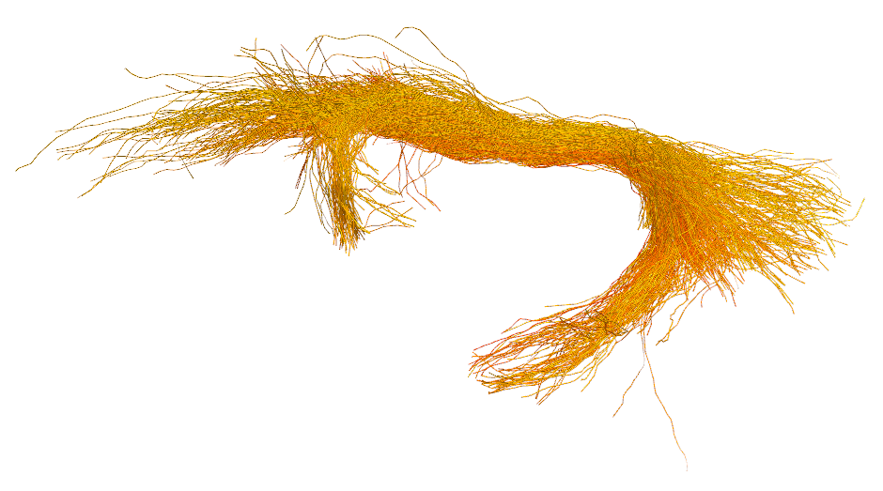
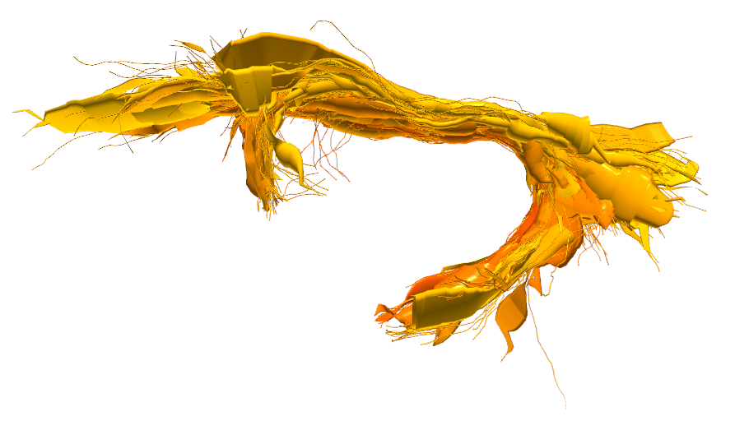
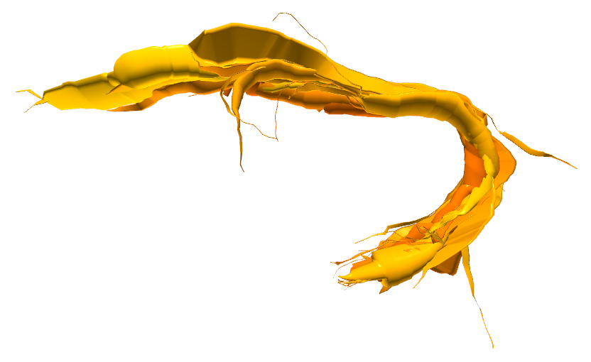
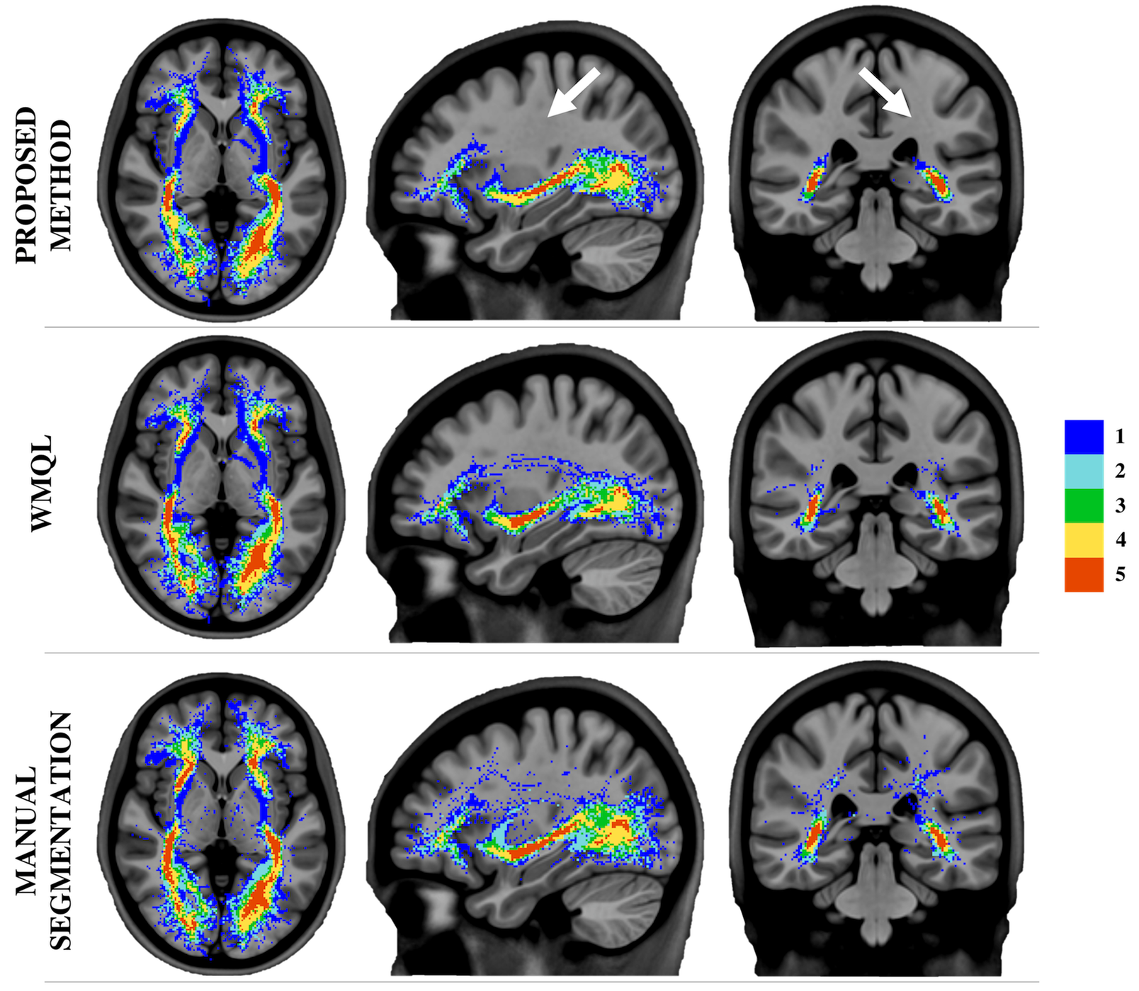






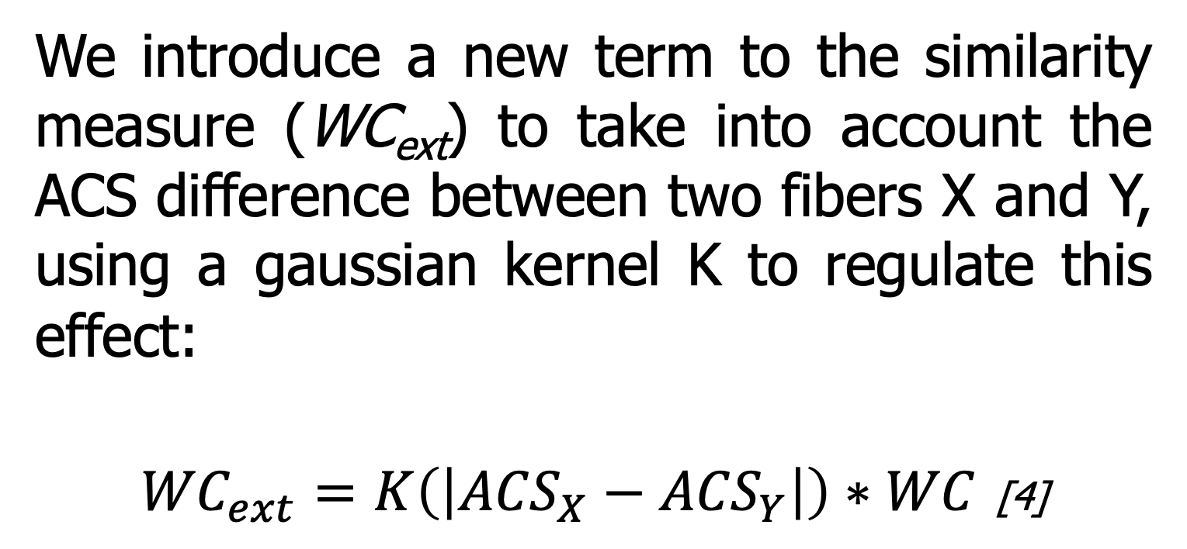
White Matter Multi-Resolution Segmentation Using Fuzzy Set Theory
*Alessandro Delmonte^{1,2}, *Corentin Mercier^{1,3}, Johan Pallud⁴, Isabelle Bloch^{1,2}, Pietro Gori¹
¹LTCI, Télécom ParisTech, Paris-Saclay University, Paris, France
²IMAG2 Laboratory, Imagine Institute, Paris, France
³LIX, Ecole Polytechnique, Palaiseau, France
⁴Neurosurgery Department, Sainte-Anne Hospital, Paris, France
INTRODUCTION / OBJECTIVE
* equally contributed to this work
We propose a method for white matter segmentation exploiting spatial relations between brain regions. We model the relations inherent incertitude relying on the spatial fuzzy set theory [1,2]. We complement this approach introducing an interactive navigation and exploration technique based on a multi-resolution brain fiber representation [3].
SPATIAL RELATIONS MODELING
Clinicians often describe white matter fiber bundles using spatial indication in relation to known brain references. These descriptions are intrinsically vague, thus needing an appropriate modelling framework. We apply fuzzy set theory to represent the fibers degree of spatial uncertainty in respect to spatial, connectivity and trajectory information (e.g. anterior of).
ACS 1
ACS 2
ACS 3
IFOF
We assign to every tract an anatomical coherence score (ACS) combining, in a conjunctive way, the satisfaction degrees for all the provided descriptions. Users are able to interactively select the bundles of interest, via an ACS based thresholding operation, with the level of precision that best fit their applications.
UF
0
ACS
1
Fig. 1: Thresholding IFOF and UF
MULTI-RESOLUTION REPRESENTATION
In order to facilitate brain navigation and to add interactivity to the segmentation process, we introduce a white matter multi-resolution representation based on [3]. Fibers are progressively merged together according to their similarity.
FIBERS
Original Bundle
CYLINDERS
Medium Resolution
CYLINDERS
Low Resolution
0.8
ACS 1
IFOF
We introduce a new term to the similarity measure (WC_{ext}) to take into account the ACS difference between two fibers X and Y, using a gaussian kernel K to regulate this effect:
${WC}_{ext}=K\left(\left|{ACS}_{X}−{ACS}_{Y}\right|\right)∗WC$ [4]
ACS 2
ACS 1
0
1
UF
ACS 2
0
Doing so, we make it feasible to navigate between thresholds in an interactive way, using the simplified geometry of the multi-resolution representation.
Fig. 2: Multi-resolution visualization of fiber bundles
RESULTS
IEEE International Symposium on Biomedical Imaging – 2019 – Venice (IT)
We validated our results on 5 unrelated healthy adults subjects from the HCP dataset.
Compared to WMQL [4] and manual segmentation, our technique presents less scattered fibers, especially in the areas connecting the temporal and frontal lobe, as shown in the dispersion colormap of figure 3.
The interactive analysis allowed neurosurgeons to better identify ACS thresholds producing the results that best represented the clinical reality.
ACS segmentation thresholds were reproducible among different subjects.
FUTURE WORKS
We plan to extend the proposed technique to more tract bundles, implementing more fuzzy relations, and perform statistical analyses.
References
Fig. 3: Tracts dispersion map
[1] I. Bloch, “Fuzzy spatial relationships for image processing and interpretation: a review”, Image and Vision Computing, vol. 23, no. 2, pp. 89–110, 2005.
[2] A. Delmonte et al., “Segmentation of White Matter Tractograms Using Fuzzy Spatial Relations”, in Organization for Human Brain Mapping (OHBM), Singapore, 2018.
[3] C. Mercier et al., “Progressive and Efficient Multi-Resolution Representations for Brain Tractograms”, in EG VCBM, 2018.
[4] P. Gori et al., “Parsimonious Approximation of Streamline Trajectories in White Matter Fiber Bundles,” IEEE TMI, vol. 35, no. 12, pp. 2609–2619, 2016.
[5] D. Wassermann et al., “The white matter query language: a novel approach for describing human white matter anatomy,” Brain Structure and Function, vol. 221, no. 9, pp. 4705–4721, 2016.
Poster n°582
Contacts:
alessandro.delmonte@institutimagine.org
corentin.mercier@telecom-paristech.fr
https://github.com/CorentinMercier/FBTS

